Slide 1

Building a Machine Learning Model using Python
Presented by: Puah Hwei Koon
Date: 10 Mar 2023
Notes:
Good morning everyone, I am Hwei Koon

Slide 2
Business Objective
Build a machine learning model,
to predict Customer Churn for Telco company
Notes:
- The business objective of this project is to build a machine learning model that can be used by the Telco company to predict customer churn.
- The machine learning model to forecast/predict which customers are at the highest risk of ending their subscription services.
- Use churn prediction models to identify which customers are at risk of churning and which areas to prioritize to increase retention. With this information, companies can take necessary steps to identify strategies that target these pain points to lower churn and increase retention rates..
-To improve retention with churn prediction analytics.

Slide 3
Contents
1. Methodology
Datasets, Models, Tools
2. Process Workflow
Step 1 - EDA,
Step 2 - Data Preparation,
Step 3 - Data Analysis,
Step 4 - ML model training/evaluation
Results
Accuracy, MSE, R^2 score, F1-score, ROC curve
Conclusions
Recommendations
Interesting insights
Notes:
This presentation is divided into 4 parts.

Slide 4
Contents
1. Methodology
Datasets, Models, Metrics, Tools
2. Process Workflow
Step 1 - EDA,
Step 2 - Data Preparation,
Step 3 - Data Analysis,
Step 4 - ML model training/evaluation
3. Results
Accuracy, MSE, R^2 score, F1-score, ROC curve
4. Conclusions
How did results of your work help with business case?
Recommendations
Interesting insights
Notes:
Let’s get started…

Slide 5







1. Methodology
Data source:
https://www.kaggle.com/datasets/shilongzhuang/telecom-customer-churn-by-maven-analytics
IDE &
Libraries:
Notes:
Telco dataset is obtained from Kaggle.
These are standard libraries that we used to build our machine learning models.

Slide 6
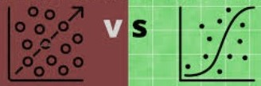
1. Methodology
Binary
Classification
Supervised
Machine Learning Models
Regression
Classification
Customer Churn?
1. Logistic Regression (LR)
2. Support Vector Machine (SVM)
3. Gaussian Naive Bayes (GB)
4. K-Nearest Neighbors (KNN)
5. Decision Tree (DT)
Yes
No
6. Multi-layer Perceptron (MLP)
7. Gradient Boosting Clf (GDB)
8. AdaBoost Classifier (ADA)
9. Random Forest Classifier (RF)
10. XGBoost Classifier (XGB)
Notes:
Our business case is to a classification problem, basically to predict if a subscriber/customer churn or not churn.
We are using 10 classification models to train and test our data.

Slide 7
Contents
1. Methodology
Datasets, Models, Metrics, Tools
2. Process Workflow
Step 1 - EDA,
Step 2 - Data Preparation,
Step 3 - Data Analysis,
Step 4 - ML model training/evaluation
3. Results
Accuracy, MSE, R^2 score, F1-score, ROC curve
4. Conclusions
How did results of your work help with business case?
Recommendations
Interesting insights
Notes:
I am going to show you the process of building the classification models.

Slide 8
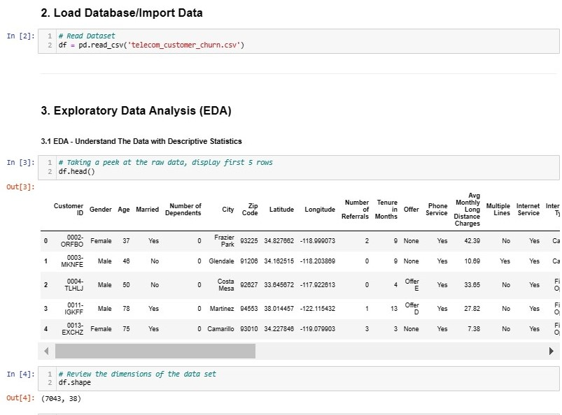
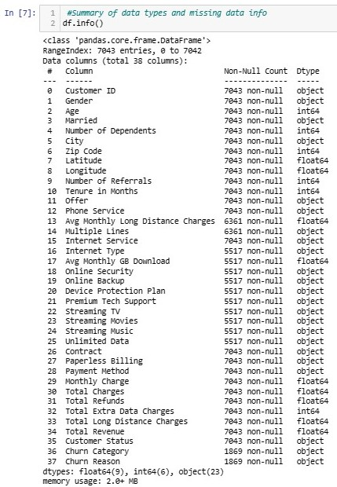
2. Process Flow
STEP 1 – Exploratory Data Analysis (EDA)

Slide 9
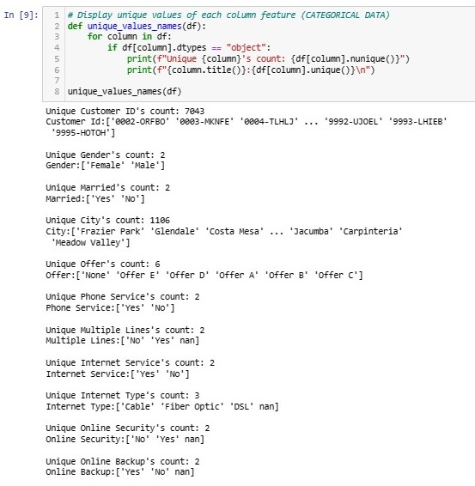
2. Process Flow
STEP 1 – Exploratory Data Analysis (EDA)

Slide 10
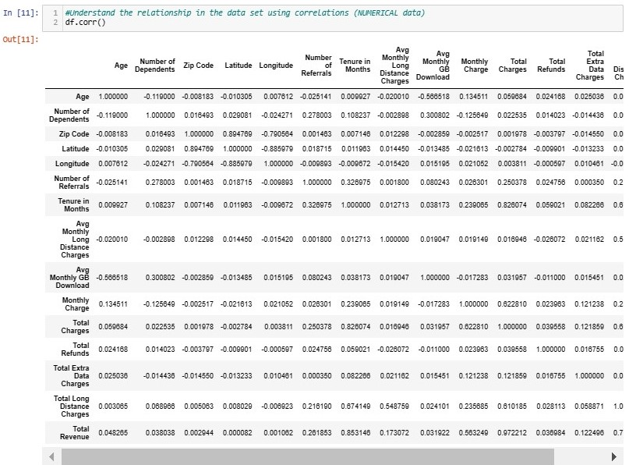
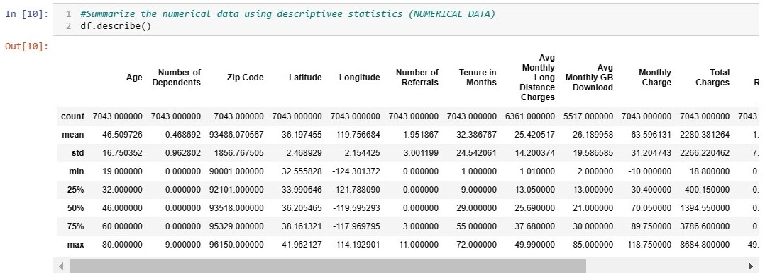
2. Process Flow
STEP 1 – Exploratory Data Analysis (EDA)
Numerical data

Slide 11
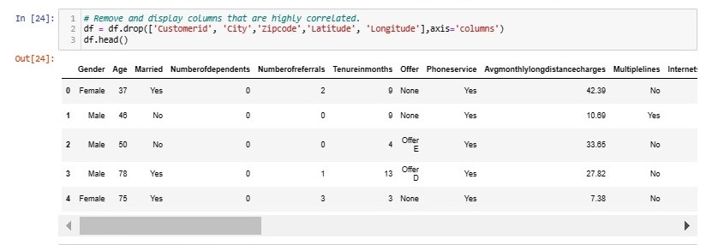
2. Process Flow
STEP 1 – Exploratory Data Analysis (EDA)
Notes:
These are IDs, unique IDs.
We have dropped these features from our dateset coz there are not going help in explaining or predicting if a customer will churn.

Slide 12
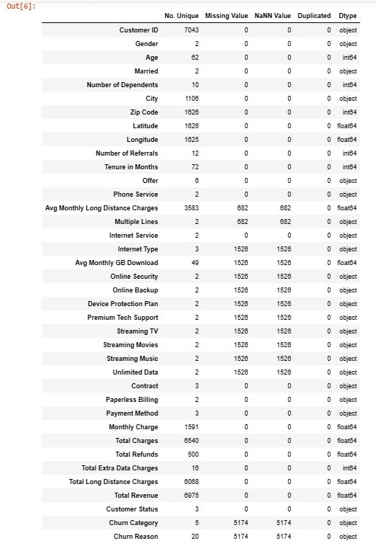
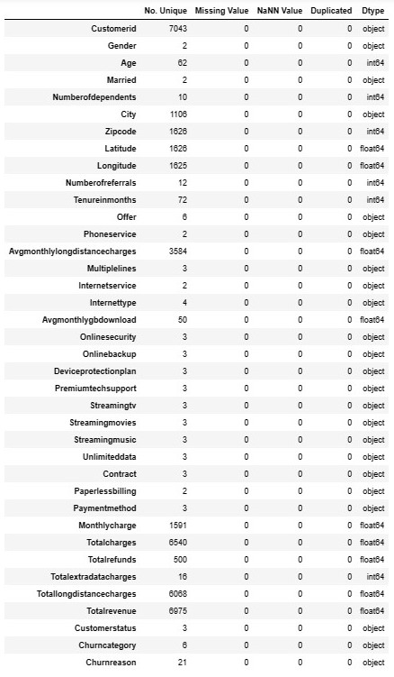
2. Process Flow
STEP 1 – Exploratory Data Analysis (EDA)
Before
After

Slide 13
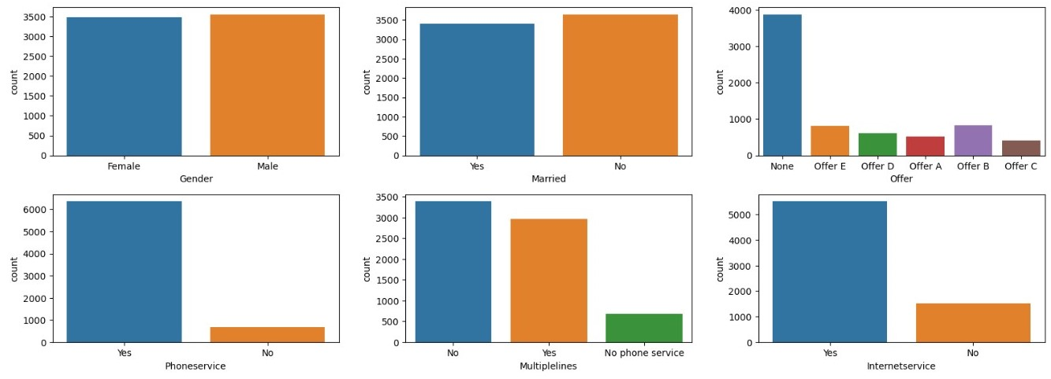
2. Process Flow
STEP 1 – Exploratory Data Analysis (EDA)
Univariate plots, countplot for categorical data

Slide 14
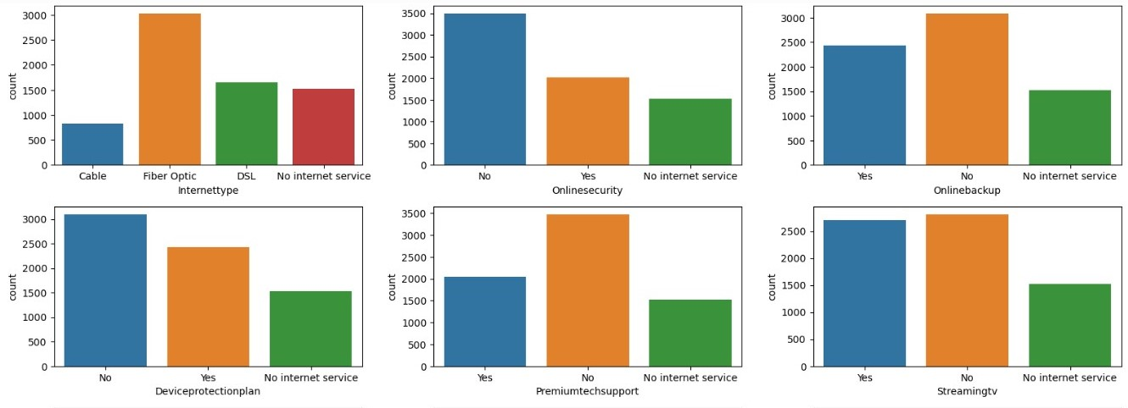
2. Process Flow
STEP 1 – Exploratory Data Analysis (EDA)
Univariate plots, countplot for categorical data

Slide 15
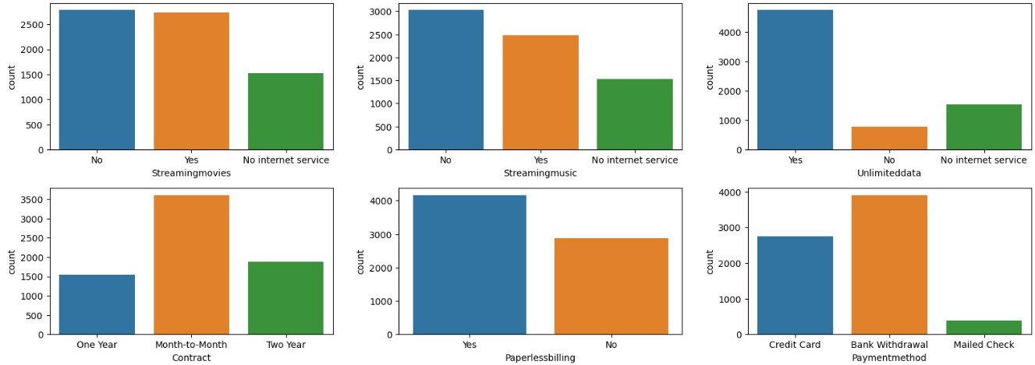
2. Process Flow
STEP 1 – Exploratory Data Analysis (EDA)
Univariate plots, countplot for categorical data

Slide 16
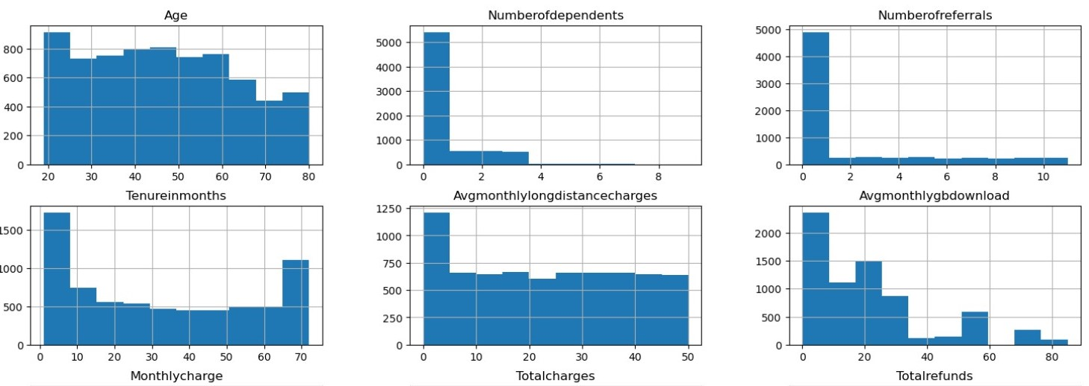
2. Process Flow
STEP 1 – Exploratory Data Analysis (EDA)
Univariate plots, histogram for numerical data

Slide 17
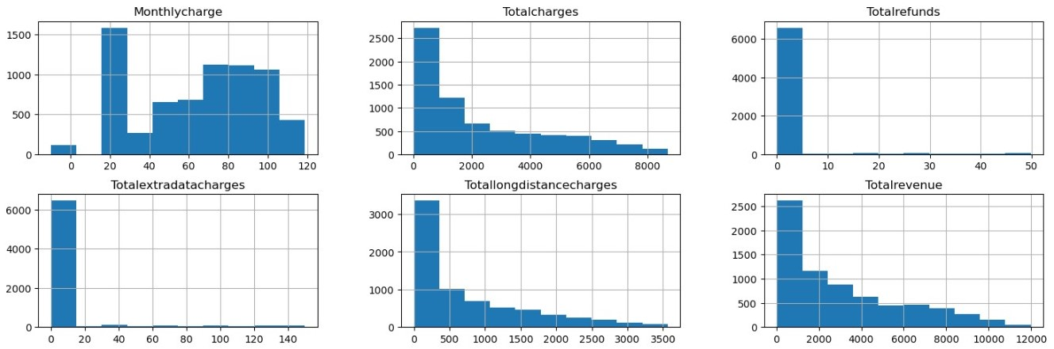
2. Process Flow
STEP 1 – Exploratory Data Analysis (EDA)
Univariate plots, histogram for numerical data

Slide 18
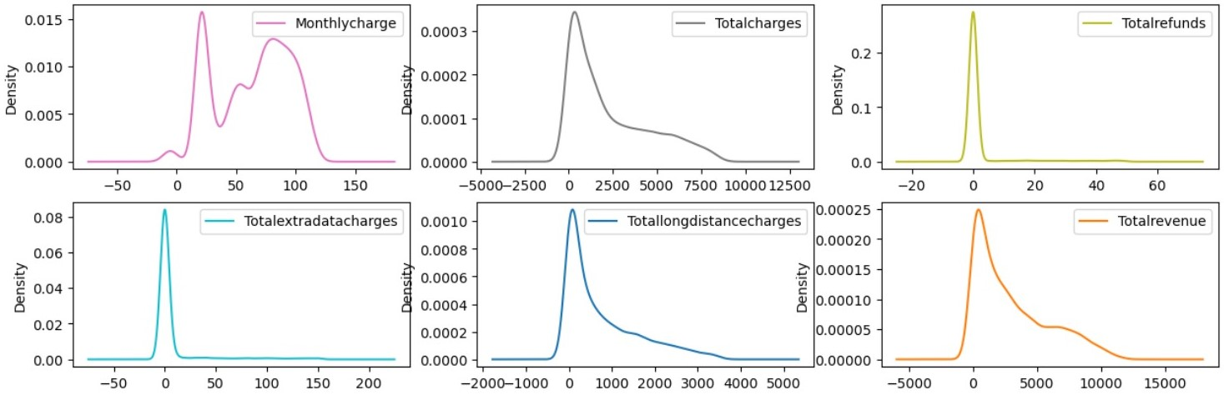
2. Process Flow
STEP 1 – Exploratory Data Analysis (EDA)
Univariate plots, density plots for numerical data

Slide 19
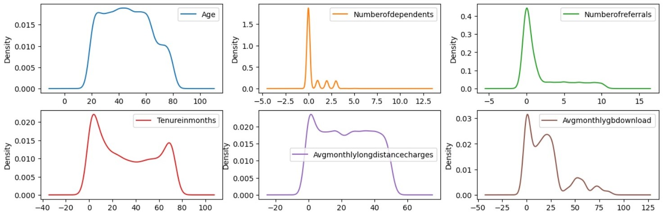
2. Process Flow
STEP 1 – Exploratory Data Analysis (EDA)
Univariate plots, density plot for numerical data

Slide 20
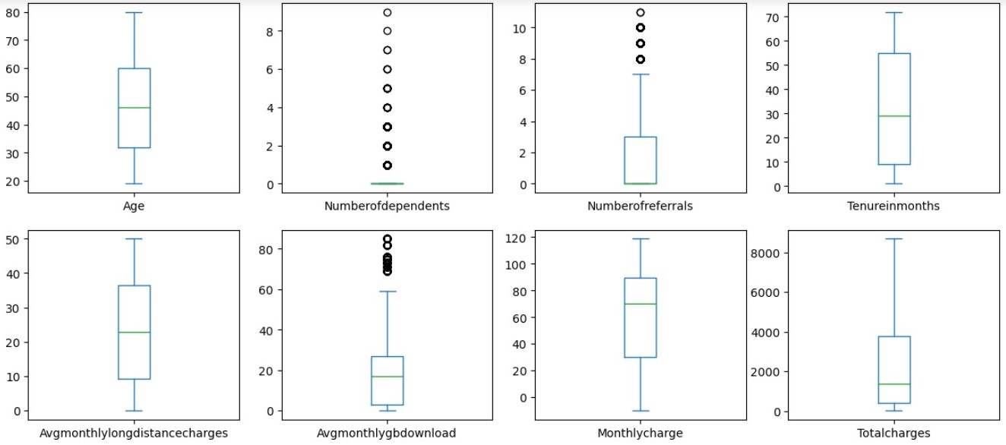
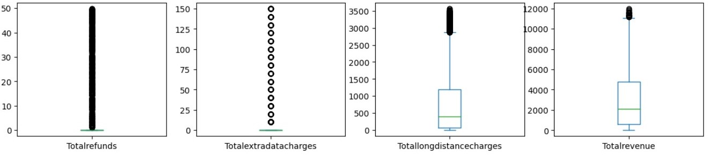
2. Process Flow
STEP 1 – Exploratory Data Analysis (EDA)
Univariate plots, boxplot for numerical data

Slide 21
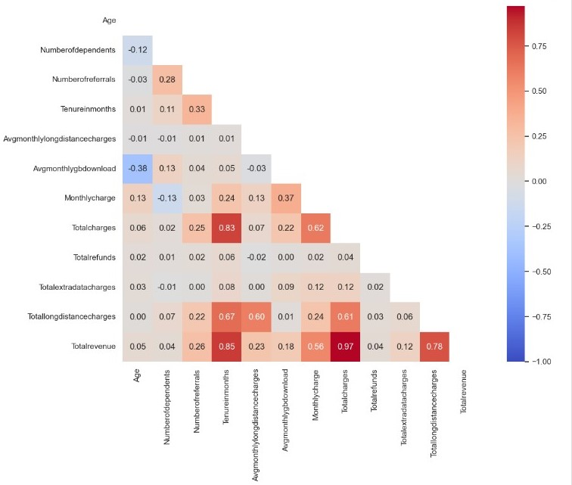
2. Process Flow
STEP 1 – Exploratory Data Analysis (EDA)
Multivariate plots, Correlation Matrix for numerical data
Total Revenue
Tenure in Months
Total Charges
Total long distance charges
Notes:
- I have highlighted the variables that are highly correlated.

Slide 22
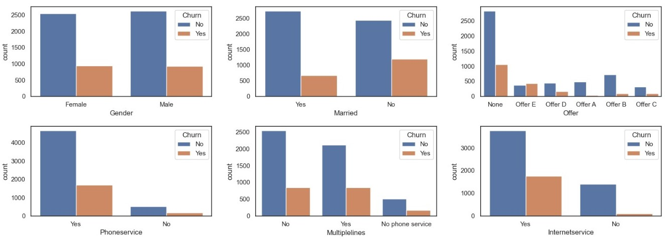
2. Process Flow
STEP 1 – Exploratory Data Analysis (EDA)
Multivariate plots, categorical features with target classes
Notes:
There are almost equal distribution of male & female subscribers.

Slide 23
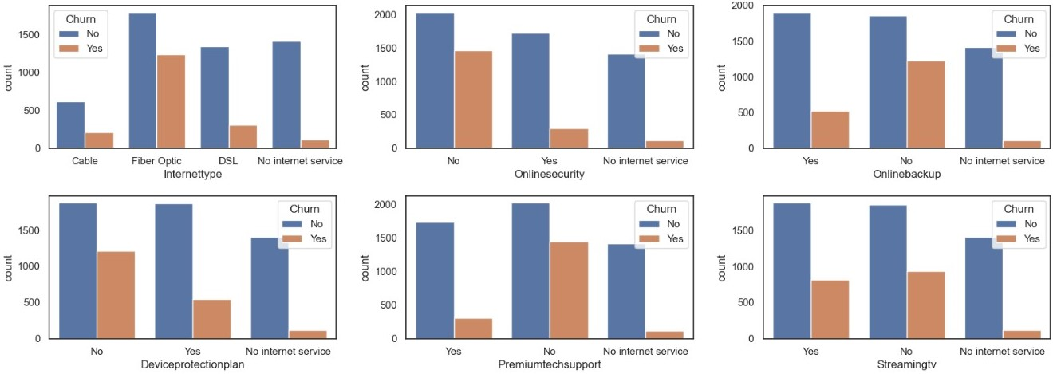
2. Process Flow
STEP 1 – Exploratory Data Analysis (EDA)
Multivariate plots, categorical features with target classes

Slide 24
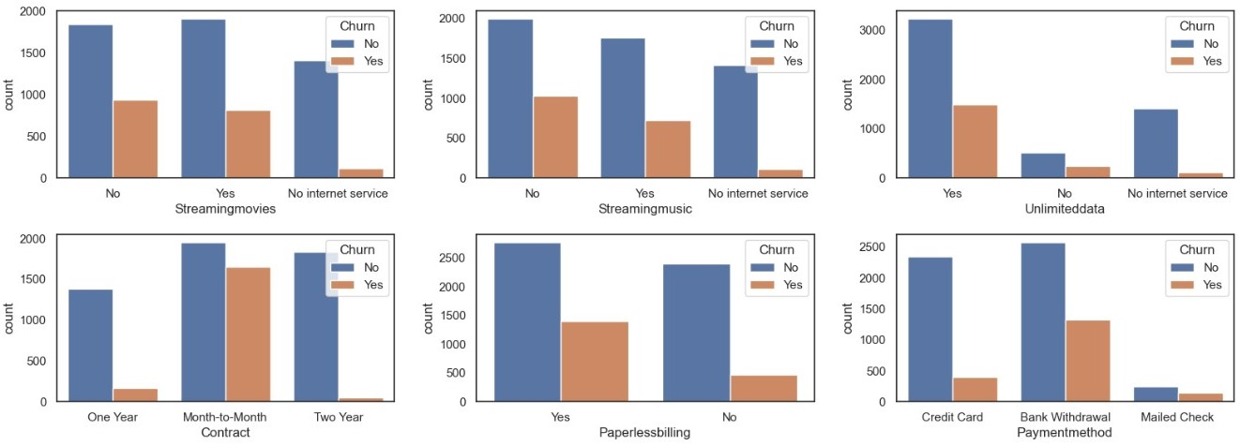
2. Process Flow
STEP 1 – Exploratory Data Analysis (EDA)
Multivariate plots, categorical features with target classes
Notes:
- Most of the subscribers are on month to month contract. These subscribers have higher churn rates compared to subscribers with yearly contracts.
-Subscribers taking a longer contract are more loyal to the company and tend to stay with it for a longer period of time.
-subscribers opted for bank withdrawal as payment method are more likely to leave the telco company.
-subscribed to paperless billing churn more than those who are not subscribed.

Slide 25
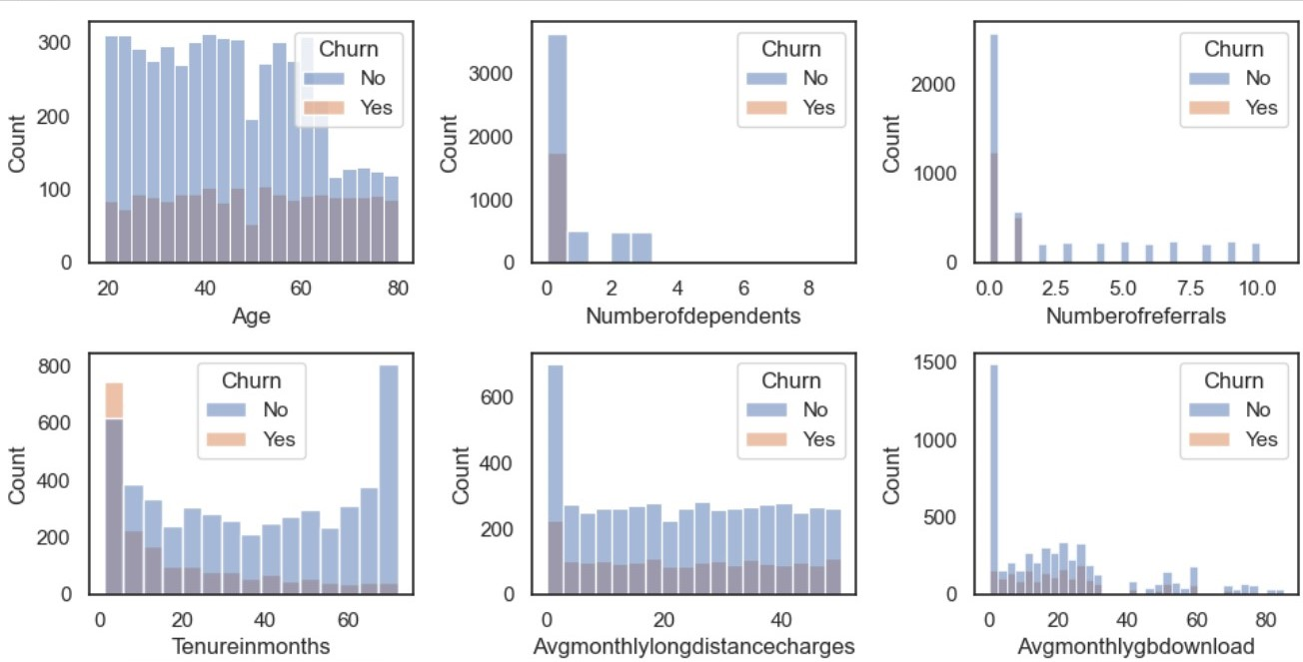
2. Process Flow
STEP 1 – Exploratory Data Analysis (EDA)
Multivariate plots, numerical features with target classes

Slide 26
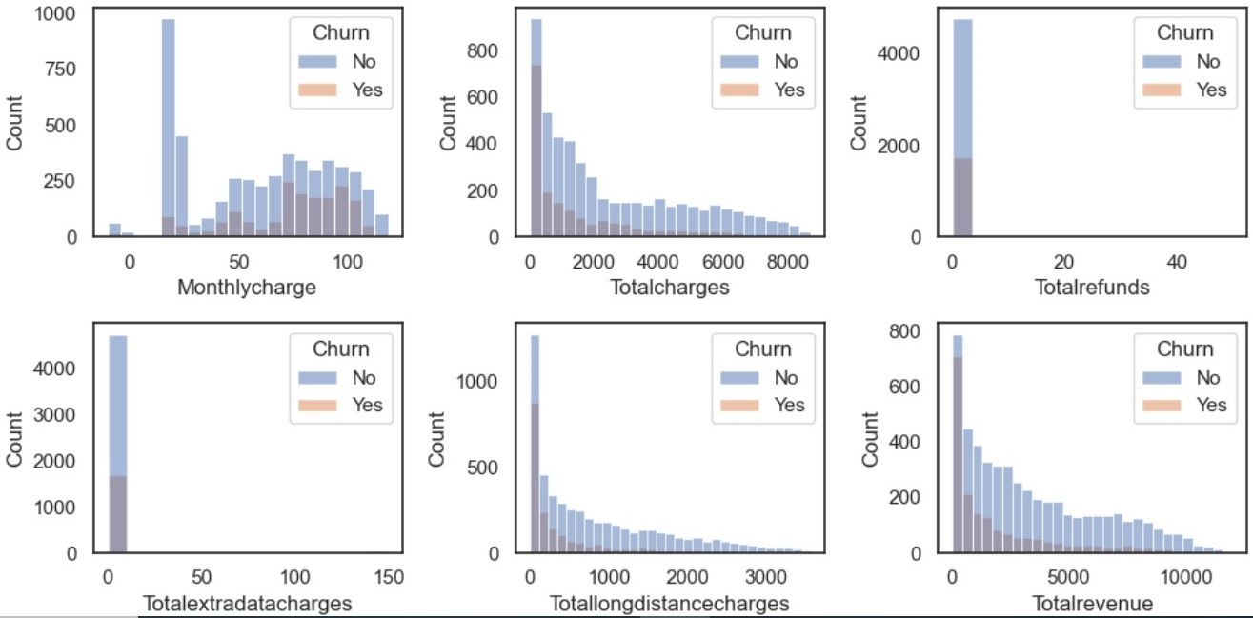
2. Process Flow
STEP 1 – Exploratory Data Analysis (EDA)
Multivariate plots, numerical features with target classes
Notes:
It seems to suggest there is higher churn when the total charges are lower

Slide 27
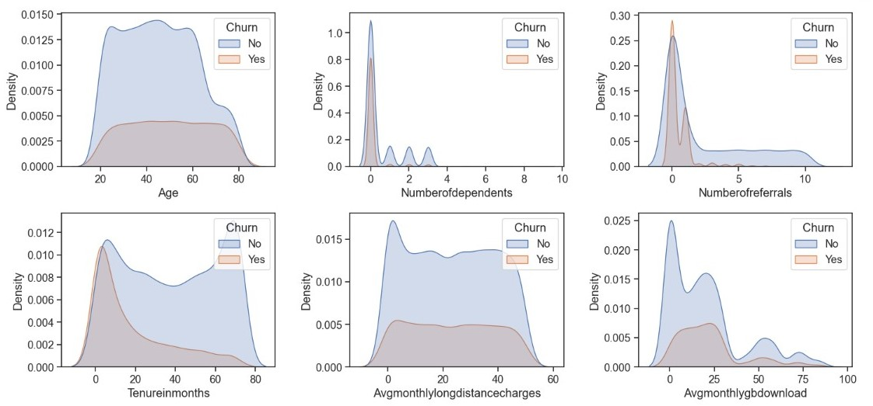
2. Process Flow
STEP 1 – Exploratory Data Analysis (EDA)
Multivariate plots, Density plot, numerical features with target classes

Slide 28
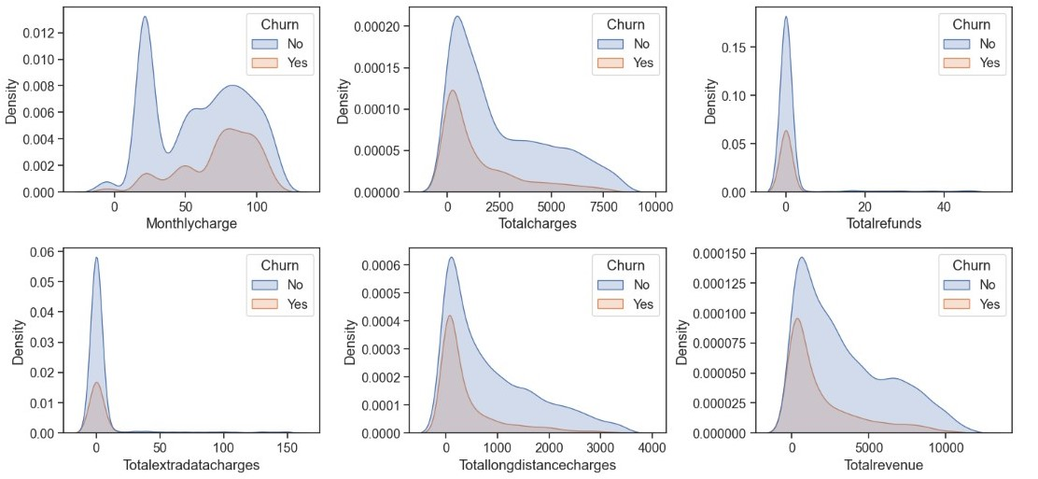
2. Process Flow
STEP 1 – Exploratory Data Analysis (EDA)
Multivariate plots, Density plots, numerical features with target classes
Notes:
It seems that there is higher churn when the total charges are lower

Slide 29
2. Process Flow
STEP 1 – Exploratory Data Analysis (EDA)
Characteristics of churn customer
S/N | Numerical data with Target classes | Categorical data with Target classes
1. | Tenure in month: Less than 6 months | Offer: None discount & Offer E
2. | No of dependents: 0 | Internet Type: Fiber Optic
3. | No of referrals: 0 | Online Security, Online Backup, Device Protection Plan, Premium Tech Support: No
4. |  | Contract: Month to month
5. |  | Payment Method: Bank withdrawal

Slide 30
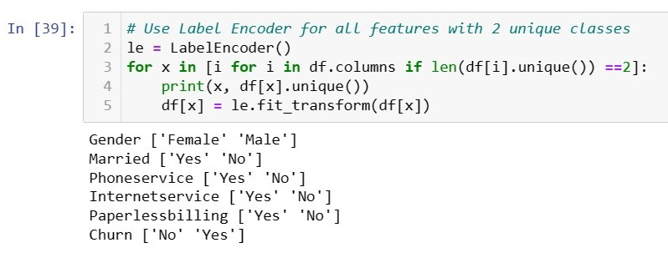
3. ML model training/evaluation
STEP 3 – Training / Evaluation
Categorical features, Label Encoder (2 unique classes)& One Hot Encoding (> 2 unique classes)

Slide 31
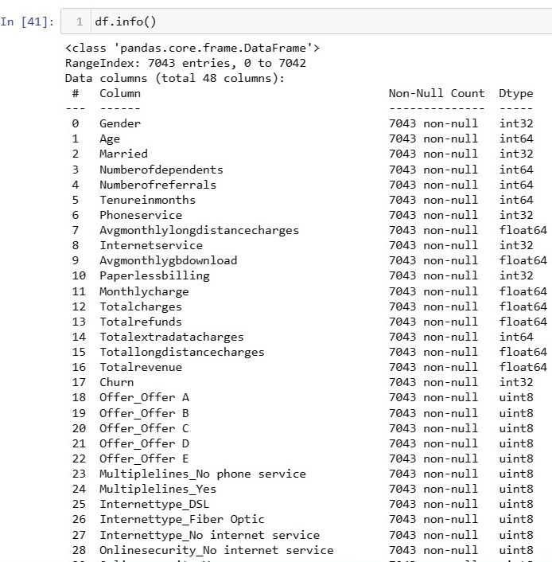
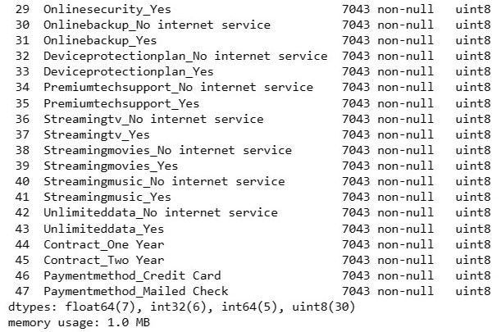
3. ML model training/evaluation
STEP 3 – Training / Evaluation
Ensure categorical variables are transformed to numeric

Slide 32
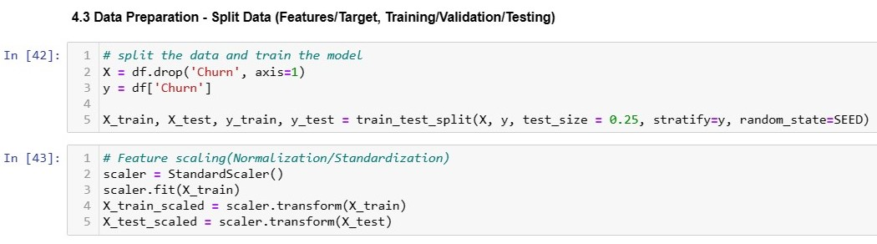
3. ML model training/evaluation
STEP 3 – Training / Evaluation
Split the data
Notes:
It is important to scale the variables so that all of the are within a range 0 to 1.

Slide 33
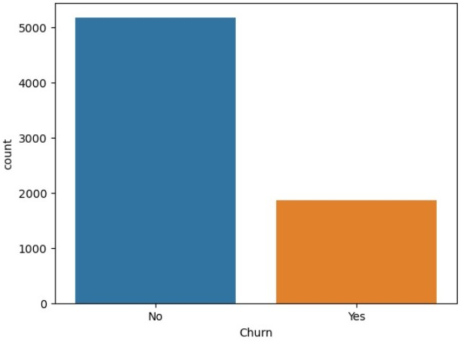
3. ML model training/evaluation
STEP 3 – Training / Evaluation
Imbalanced dataset

Slide 34
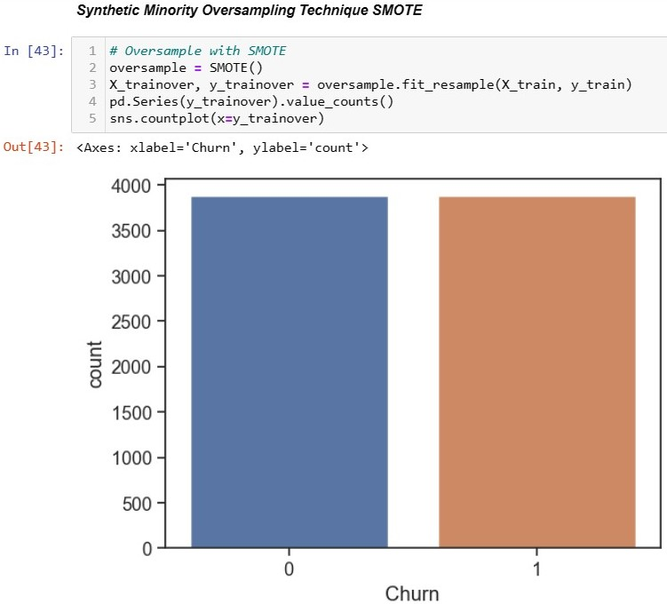
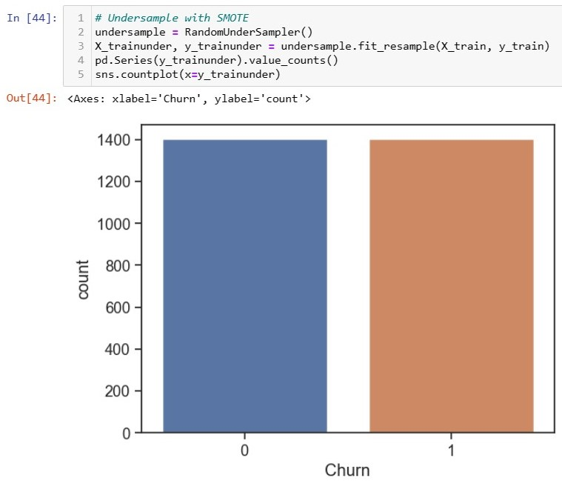
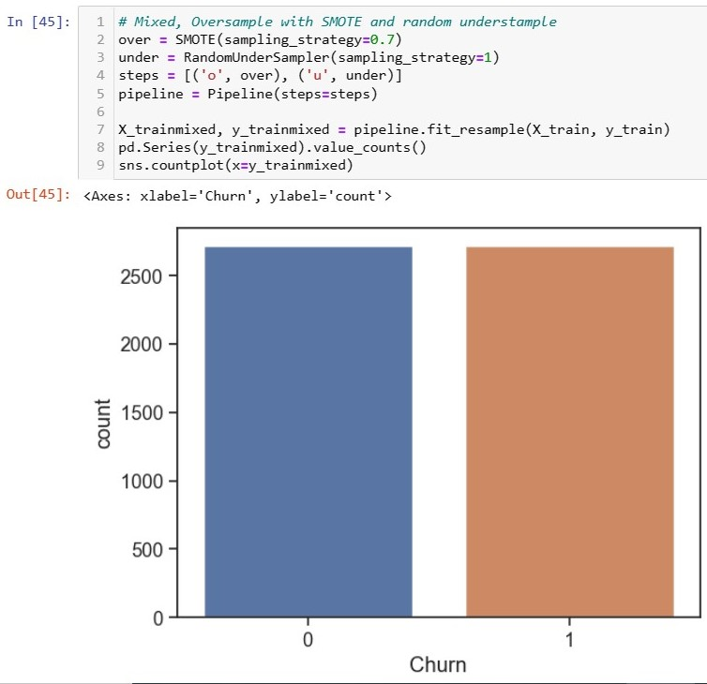
3. ML model training/evaluation
STEP 3 – Training / Evaluation
Resampling using SMOTE

Slide 35
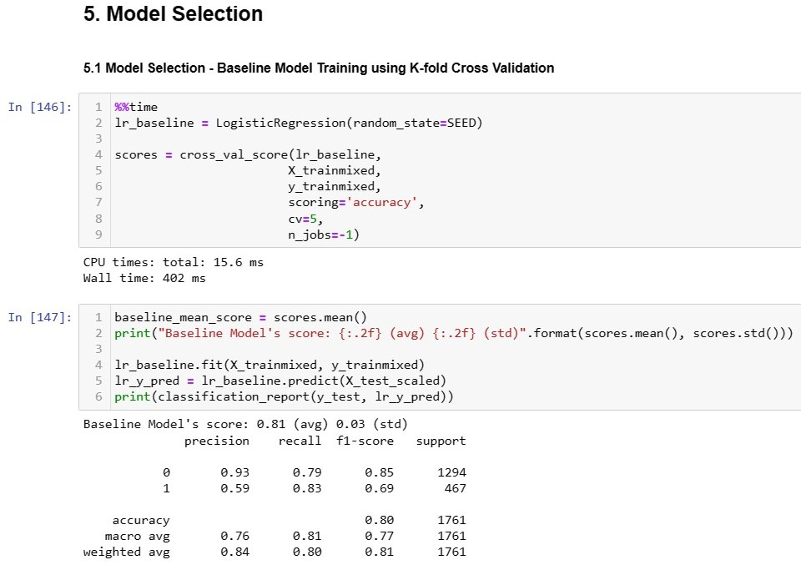
3. ML model training/evaluation
STEP 3 – Training / Evaluation
Split the data

Slide 36
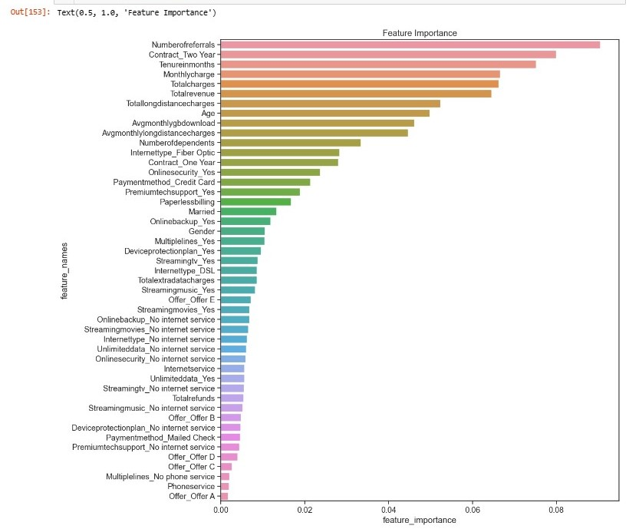
3. ML model training/evaluation
STEP 3 – Training / Evalution
Feature Importance

Slide 37
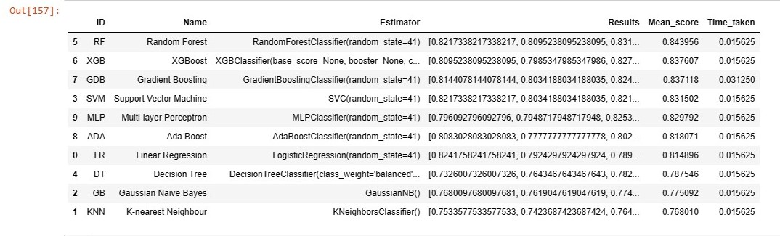
3. ML model training/evaluation
STEP 3 – Training / Evaluation
Comparison of mean score

Slide 38
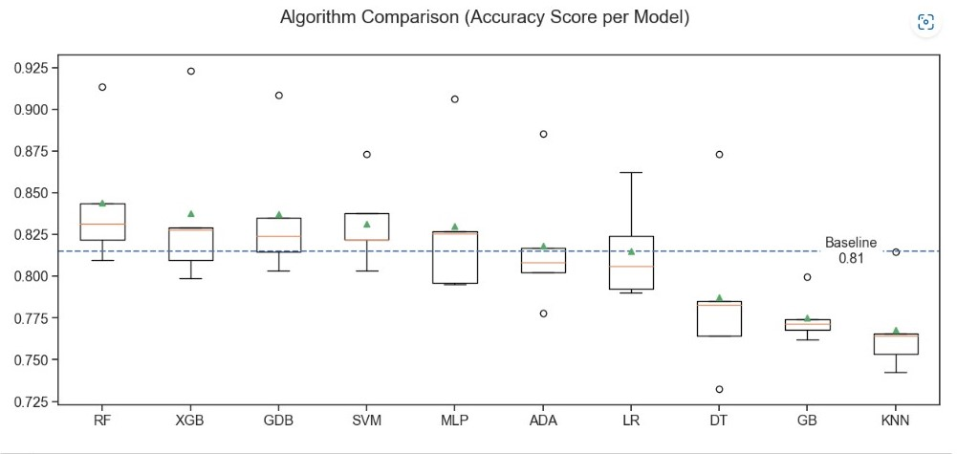
3. ML model training/evaluation
STEP 3 – Training / Evaluation
Comparison of accuracy score per model

Slide 39
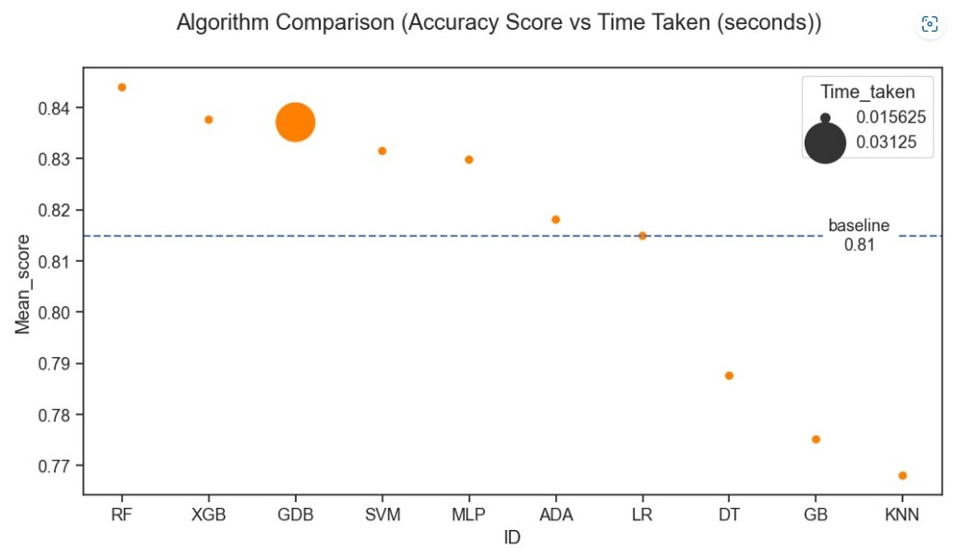
3. ML model training/evaluation
STEP 3 – Training / Evaluation
Comparison of time taken by each model

Slide 40
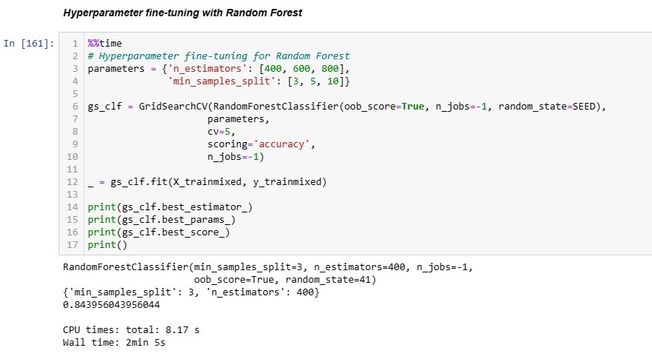
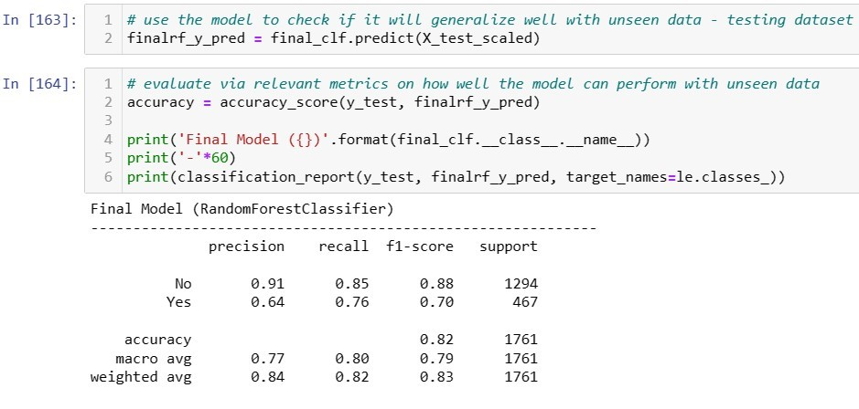
3. ML model training/evaluation
STEP 3 – Training / Evaluation
Hyperparameter fine-tuning

Slide 41
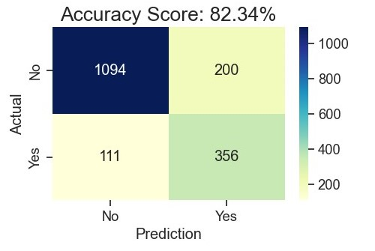
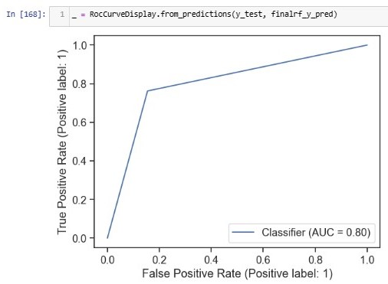
3. ML model training/evaluation
STEP 3 – Training / Evaluation
Confusion Matrix & ROC curve
Notes:
For business case, our focus is accuracy, as you can see from the confusion matrix, the accuracy of the model appears to be high, 82.34%.
ROC curve indicates true positive rate of 0.8. The area under curve is more than 0.5.

Slide 42
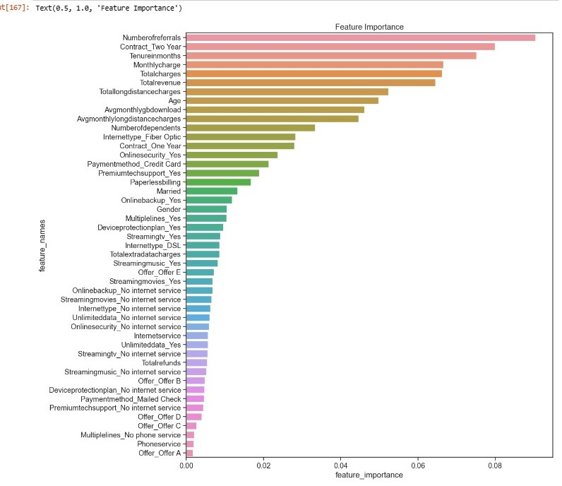
3. ML model training/evaluation
STEP 3 – Training / Evaluation
Final feature importance
Feature Importance:
Number of referrals
Contract_Two Year
Tenure in months

Slide 43
Contents
1. Methodology
Datasets, Models, Tools
2. Process Workflow
Step 1 - EDA,
Step 2 - Data Preparation,
Step 3 - Data Analysis,
Step 4 - ML model training/evaluation
3. Results
Accuracy, MSE, R^2 score, F1-score, ROC curve
Conclusions
Recommendations
Interesting insights
Notes:
This presentation is divided into 4 parts.

Slide 44
4. Conclusion
s/n | Conclusion
1 | 10 machine learning models were built and trained Random Forest outperformed other models
2 | The Most important features are as follows, and they are important predictor variables to predict churn. No of referrals Contract two years Tenure in months
3 | Recommendations from EDA process: Subscribers are likely to churn if they opt to pay at a monthly basis. company to consider to provide incentive for subscribers to convert to two years contract. Creation of new quarterly contract, provide proper incentives to adopt longer contracts, since longer contracts have a better customer retention rate. Subscribers are like to churn if they are not taking up additional adds-on services. Company to consider to provide incentive to add additional services by offering bundling at a discounted rate. There is a higher chance to retain customers and convert them to become high value customers after purchasing these add-on offers.
Notes:
From RF algorithm the most important features are …. They are the most important predictor variables to predict churn.
Use churn prediction models to identify which customers are at risk of churning and which areas to prioritize to increase retention. With this information, companies can take necessary steps to identify strategies that target these pain points to lower churn and increase retention rates..
To improve retention with churn prediction analytics.

Slide 45
The End
Thank you!

